Slide 1
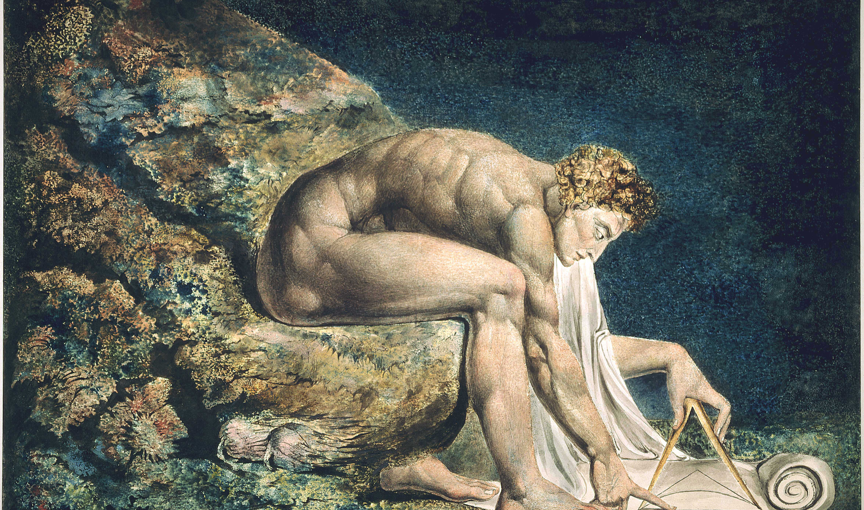
Isaac Newton, by William Blake

Slide 2
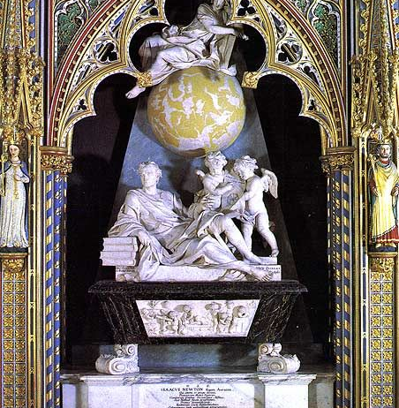
Newton’s Monument at Westminster

Slide 3

I’m opening this final section of HPS210S with a photo taken at Westminster Abby, the burial place for British royalty, statesmen, poets. Chaucer is buried here, in a corner surrounded by other poets.
Note that Newton’s tomb is up front, alongside the tomb of one other person – Horatio Nelson – who led the British to victory of the Battle of Trafalgar. A scientist and a sailor are honored here ahead of monarchs and statesmen.
Isaac Newton died in 1727. During his lifetime and for a short period thereafter, his scientific ideas were not part of the scientific consensus. It was not until 1740 or so that text books based on his ideas started to be taught at leading universities in Europe and in North America. BY 1750 or so, his ideas had come to be seen as a framework or a template for all of intellectual endeavors, and many social and political reforms, not just science.

Slide 4
Newton’s Legacy
Newton contributed to many different fields of inquiry.
He was a practicing alchemist for most of his life and used his knowledge of metals to great effect when he was made Master of the Mint of England. During his tenure, many forgers met their death due to the analyses and judgement provided by Newton.
Newton was also an expert on the Old Testament. In his The Chronology of Ancient Kingdoms Amended (1728), he attempted to reconcile Jewish and pagan dates, and to fix them absolutely from an astronomical argument about the earliest constellation figures devised by the Greeks. In Observations upon the Prophecies of Daniel and the Apocalypse of St John (1733), Newton also wrote on Judeo-Christian prophecy, sustained by the conviction that its decipherment was essential to the understanding of God.

Slide 5
Newton’s Work in Mathematics
In terms of his straightforward scientific interests, there are three central areas that drew Newton’s attention.
The first is mathematics. Newton laid the foundations for the differential and integral calculus. He produced simple analytical methods that unified many different techniques that had been developed to solve problems that were thought to be unrelated. In particular, he was renowned for his solutions to the problems in analytical geometry of drawing tangents to curves (differentiation) and defining areas bounded by curves (integration). Newton discovered that these problems were inverse to each other, and designed general methods of resolving problems of curvature — his “method of fluxions” (from the Latin meaning "flow") and “inverse method of fluxions.” Fluxions were expressed algebraically, but Newton made extensive use of analogous geometrical arguments.

Slide 6
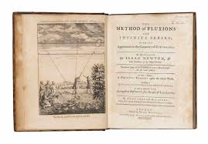
The Method of Fluxions (1736)

Slide 7
Work in Optics
Newton constructed the first telescope that used a curved mirror to prevent light from being broken up into unwanted colors. He was elected a Fellow of the Royal Society in 1665 for this telescope.
He also contributed to optics by showing that homogenous white light is made up of the colors of the rainbow. In a remarkable experiment, Newton passed one of the beams of colored light through a second prism and showed that it was not colored by the spectrum and so must be a constituent of white light.
Reactions to Newton’s experiment were negative. The inability of the French physicist Edmé Mariotte to replicate Newton’s prism experiments in 1681 entrenched the rejection of Newton’s optical theory for a generation. Newton delayed the publication of his Opticks (published in 1704; revised in 1706), which was largely composed in 1692, until his critics were dead. The manuscript of his original lectures was printed in 1729 under the title Lectiones Opticae.

Slide 8
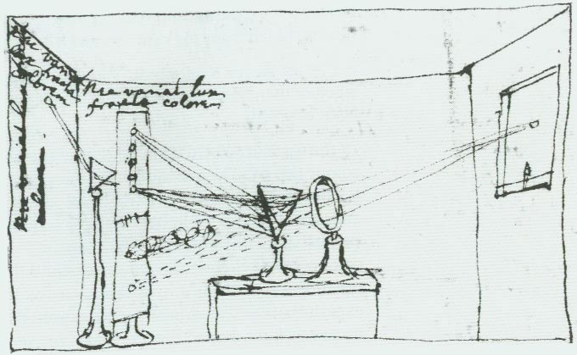
Newton’s drawing of his experimentum crusis

Slide 9
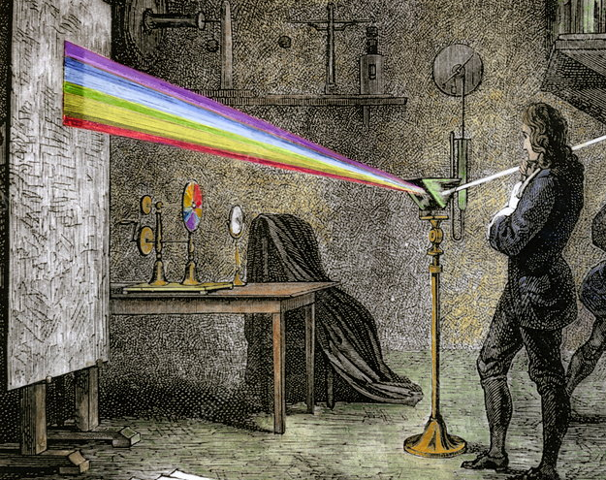
Colored drawing of Newton’s experiment

Slide 10
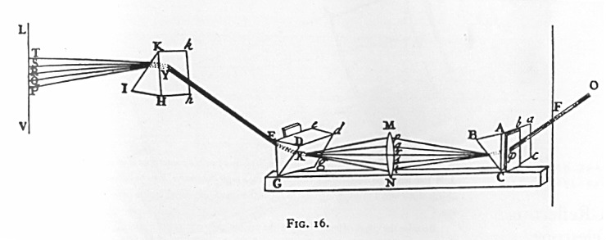
Reconstruction of Newton’s Experiment

Slide 11
Newton’s Great Idea
Newton’s great idea was the law of universal gravitation.
In the 17th century, people were well aware of the particularities of their situation. There were many languages, many sets of customs, many systems of justice. Life hummed in many distinct patterns.
Newton gave the world a universal expression that applied to all bodies whatsoever. He expressed this relationship in a precise and quantitative form. In doing so, he unified entire branches of science that were long thought to be distinct (celestial and terrestrial mechanics) and gave a blueprint to others in their attempts to find unity is a world filled with disunity.

Slide 12
Newton’s Style of Reasoning
Indeed, Newton’s treatment of such phenomena as the eccentric orbits of comets, the tides and their variations, the precession of the Earth's axis, and the motion of the Moon as perturbed by the Sun's gravity arguably created the science of physics and the form or characteristic style of explanation that we find in Newton's seminal treatise— The Principia (1687) -- still holds sway in physics today.

Slide 13
Newton’s Annus Mirabilis (1666)
Anyone of these contributions would have secured Newton a prominent place in the pantheon of science. Taken together, it is clear why his achievements cast such an immense shadow across the physical sciences.
What is remarkable is that the central insights that shaped his contributions to all three areas emerged during the period (1666) when Newton was hiding out in the country due to the devastating outlook of the plague in London.

Slide 14
The End of Science
So dominant were Newton’s ideas that most scientists came to believe that these ideas would never be repealed – we may add to Newton’s work by studying forces other than the gravitational force – but the fundamental system of the world as modeled by Newton was thought to be fundamentally correct and irrevocable. There never could be another scientific revolution. So, of course, it came as a great shock when the 20th century witnessed 3 or 4 changes in fundamental ideas in the physical sciences.

Slide 15
Newton’s Rules of Reasoning
Newton included at the beginning of Book 3 in the second (1713) and third (1726) editions of his Principia a section entitled "Rules of Reasoning in Philosophy." In the four rules, as they came finally to stand in the 1726 edition, Newton effectively offers a methodology for handling unknown phenomena in nature and reaching towards explanations for them

Slide 16
Rule 1
Rule 1 We are to admit no more causes of natural things than such as are both true and sufficient to explain their appearances.
This rule is generally called the principle of parsimony. It is based on the conviction that nature is simple and explanations for its phenomena must be simple as well or at least the simplest explanation must be the most likely.

Slide 17
Rule 2
Rule 2 Therefore to the same natural effects we must, as far as possible, assign the same causes.
The second rule essentially means that special interpretations of data should not be used if a reasonable explanation already exists.

Slide 18
Rule 3
Rule 3. The qualities of bodies, which admit neither intensification nor remission of degrees, and which are found to belong to all bodies within the reach of our experiments, are to be esteemed the universal qualities of all bodies whatsoever.
We find that all bodies have inertia, mass, extension. Newton strongly resists the suggestion that gravitational attraction is a primary property of matter.
Another implication of this rule is that the laws of nature are invariant. Bodies will be governed by the same set of laws in North America and in the far reaches of space as they are here on Earth.

Slide 19
Rule 4
Rule 4. In experimental philosophy, we are to look upon propositions inferred by general induction from phenomena as accurately or very nearly true, not withstanding any contrary hypothesis that may be imagined, till such time as other phenomena occur, by which they may either be made more accurate, or liable to exceptions.

Slide 20
Newton’s Achievement
Overall, what Newton managed to do was to provide a remarkable new solution to a very old problem – what is the center of the planetary system, the Earth or the Sun? Some had sided with the ancient view of a geocentric universe because it accorded so well with common sense. We do not have a sensation of a moving Earth, etc. Others took up the new idea for any number of reasons but one was that it presented an interesting challenge to scientists to fashion a physics of a moving Earth.
From the date of the publication of On the Revolutions of the Heavenly Spheres in 1543 by Copernicus, no one had arrived at anything life a physics for a moving Earth.

Slide 21
From Kepler to Newton
One mathematician, as we have seen, who was very taken with Copernicus’ hypothesis was Johannes Kepler. He inherited some data on the observed positions of Mars at very particular times in its orbit, and found that the planets did not do what Copernicus had suggested. Rather they moved around the Sun in squashed circles or in elliptical orbits. This is not quite true but happens to be approximately true for Mars, which has a very eccentric orbit.

Slide 22
Kepler also found that there was a very particular relationship between the time that the planets took to do around the Sun (the planet) year and their distances from the Sun. The square of the planet’s orbital period is proportional to the cubes of their mean orbital radius. This relationship (formalized in Kepler’s third law of planetary motion) was a constant for all planets, irrespective of their distances and their masses. Clearly, the Sun played a very prominent role in this dance of the planets but Kepler was unable to explain why the planets moved as they did.

Slide 23
Newton and the Story of the Apple
The story goes that Newton saw an apple fall to the ground and it made him wonder why the fruit always fell straight to the ground; why did it not veer off to the left or right? Newton’s own intuition, encapsulated in his law of inertia, was the anything that begins moving from a standing start is experiencing the action of a force. The apple started in the tree and landed on the Earth, which means there must be a force of attraction between the apple and the Earth.
And even if the apple were higher up in the tree, it would still feel this force of attraction with the Earth, reasoned Newton. In fact, the attraction shouldn't even stop at the top of a tree but carry on way up into the heavens. Which raised the question: if everything around the Earth should feel this force of attraction, including the Moon, why doesn't the Moon, our nearest neighbor, fall and crash onto the surface of our planet in the same way as the apple did?

Slide 24
Newton’s Orbital Cannon
Newton accepted the obvious consequence of his line of thought: the Moon was indeed falling towards Earth, just as the apple felt the gravitational force, but there was a very good reason why it didn't crash down.
He used a thought experiment why: imagine you fired a cannonball horizontally from the top of a mountain on Earth. The ball would follow a curved trajectory as it moved forward and was attracted, by gravity, towards the ground at the same time. Fire the cannonball with more energy and it would land further away from the mountain, but it still would follow a curved trajectory in doing so.

Slide 25
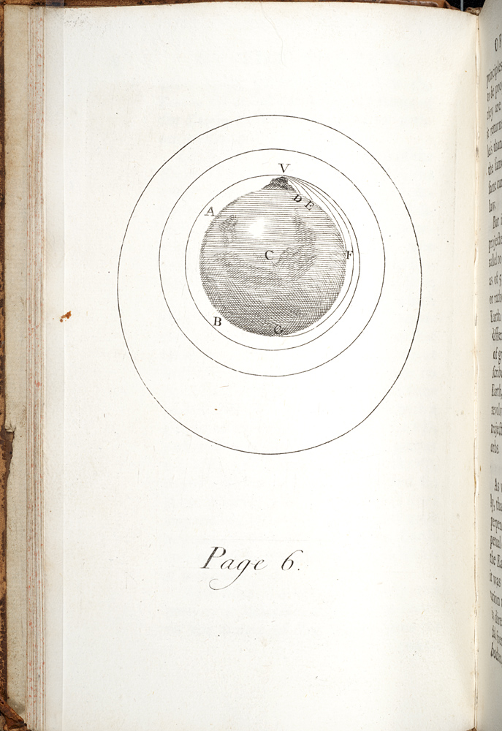
Newton’s orbital cannon (Principia, 1687)

Slide 26
The Moon as a Satellite
If even more energy were added to the firing of the cannon, eventually the ball’s own force and the gravitational pull of the Earth would balance each other: the cannon would move fast enough so that the gravity of the Earth never quite catches it. This is a very difficult concept for students, but it is the heart of Newton’s great discovery of 1666.
There is a great deal of controversy amongst historians whether any of this is true. Newton passed along the story of the apple in his dotage but what we do know is that in 1684, Newton produced a mathematical proof, which became the basis for the monumental Principia that he published three years later in 1687. The question he asked was: How far would the Moon fall if it stopped in its tracks? Newton calculated that in one minute the Moon, if stopped, would fall the same distance as would an object on Earth in one second: a convenient 60:1 ratio, a result of the lunar distance between sixty Earth-radii. This (so-called) Moon test was perhaps the most original of Newton’s arguments

Slide 27

The Problem of the Planets
18 years later, Newton would provide a mathematical proof for his youthful conjecture about the universality of gravitational attraction and he would go on to relate his Kepler’s laws of planetary motion, showing that for the most part Kepler’s laws are incorrect. His novel solution to the long-standing worries about whether the sun or the earth is at the center of the planetary system was that neither is at the center. The center, in fact, is the central of gravity for the system as a whole, which, as it happens, nearly coincides with the Sun simple because most of the mass of the solar system is part of the Sun

Slide 28
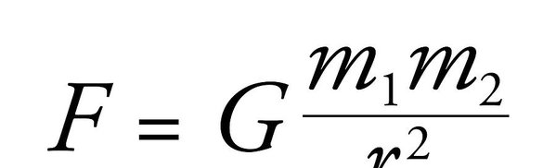
Newton’s Law of Universal Gravitation

Slide 29
The Inverse Square Relationship
Newton's law tells us that the strength of the gravitational force between two objects drops off in the same way that a light gets dimmer as you move away from it, a relationship known mathematically as an inverse square law.
Another way to visualize the drop-off in the field is to imagine the gravitational field around an object as a series of concentric spheres. Each sphere represents the same "amount" of gravitational field but the spheres further from the object are bigger, so that same amount of field is spread thinner, over a larger area. The field thus gets weaker as you move away from the object, in proportion to the surface areas of these spheres.
The m1 and m2 could be planets and stars or they could be you and the Earth. Compute the equation using numbers for your mass and that of the Earth, and you will get your weight, measured in Newton’s. Weight, in true scientific terms, is the gravitational force acting on your mass (which is measured in kilograms) at any point in time. Your mass will stay the same wherever you go in the universe but your weight will fluctuate depending on the mass and position of the objects around you.
Newton's law of gravitation is a simple equation, but devastatingly effective: plug in the numbers and you can predict the positions of all the planets, moons and comets you might ever want to watch, anywhere in the solar system and beyond.

Slide 30
Applications
And it allowed us to add to those celestial bodies too, heralding the space age. Newton's formula helped engineers work out how much energy we needed to break the gravitational bonds of Earth. The path of every astronaut and the orbit of every satellite from which we benefit – whether for communications, Earth observation, scientific research around Earth or other planets, global positioning information – was calculated using this simple formula.

